Slide 1

Lab Book 5. Resonators - RR
Student:

Slide 2
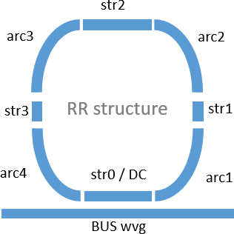
Instructions
General
SOFTWARE
Python notebook supplied by instructors
SCRIPTS
From Poliformat → download the 4.0._RESONATORS_RR_Student.ipynb
Either run locally or at Google Collaboratory
COMPONENT to be studied: Ring Resonator (RR)
Input 0
Output 0

Slide 3
ASSESSMENT #1 – Recap from theory
1.1. What happen when changing the value of the n_g (group index)?
1.2. How does propagation loss influence the response of the RR? (Translate natural units to dB/um units)
Document all your results (neff, ng, alpha, gamma, transfer function plots, etc.) and comment on the obtained results (in terms of FSR, amplitude, losses, etc.).

Slide 4
ASSESSMENT #2 – SAX model
Define a Ring Resonator SAX model for the structure depicted in Figure 2 including:
• A directional coupler.
• Straight and curved waveguide segments.
• Include parameters like coupling gap, bend radius, and the presence/absence of straight segments between bends.
2.1. Check if there is any variation of having or not straight sections between bends. How does the bend radius influence then?
Document all your results (copy here the code employed to obtain the transfer function employing SAX modeling and include the comparative plot of the models)

Slide 5
ASSESSMENT #3 – SAX verification
Design a narrowband optical filter based on a RR with an 𝐹𝑆𝑅_𝜆0 = 14 𝑛𝑚 for a SOI cross-section of 450 nm x 220 nm (W x H). Compare the response obtained from both models (SAX model and formulation model) to verify the results.
(*Import the attached .txt file to get the corresponding neff and wvl data.)
Document all your results (calculus of RR length, code, transfer function plot, etc…)

Slide 6
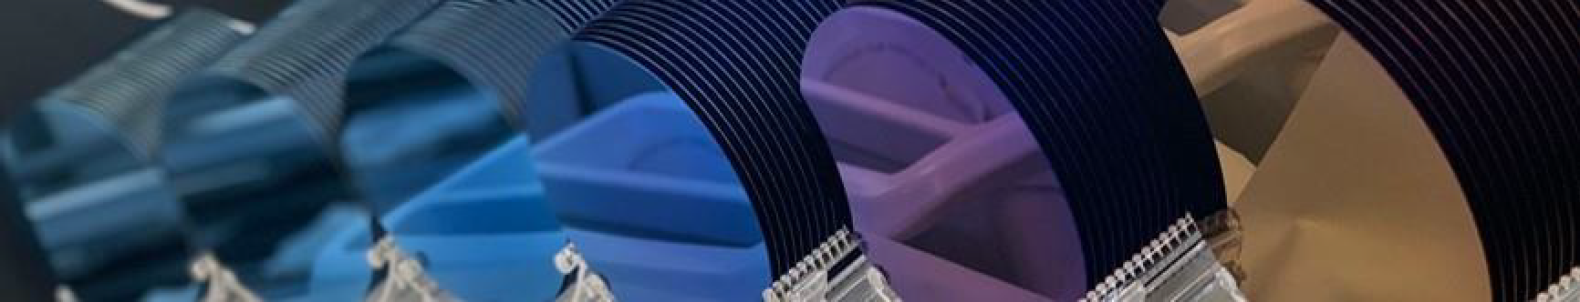
Thank you

